Slide 1
Weekly Monitoring
From 09/06 to 19/06
Lucas

Slide 2
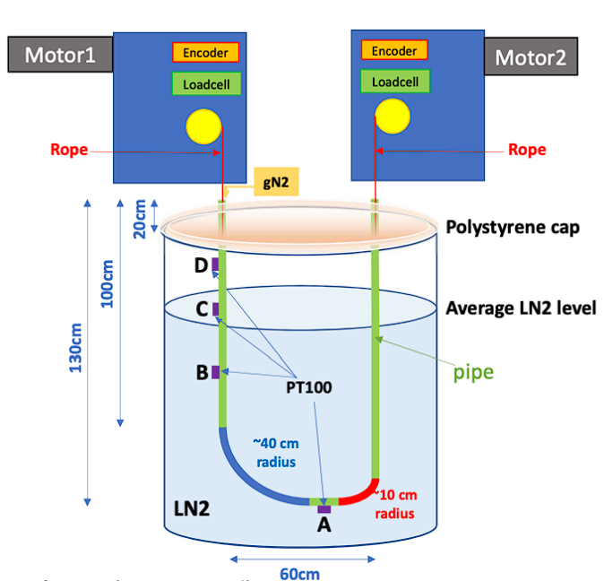
Summary :
Date | Hour | Ice Formation | °C | Tension (N) | %LN2 in tank | gN2 flow (L/h) | Voltage (V) | Current (A)
Fri - 06/09 | 18:00 | Yes | A,B,C LN2 D ~-170° | DS2: 17 DS4: 6 | 98% | >250 (no T) | V2 : 24 V4 : 24 | I2 : 0.08 I4 : 0.08
Sat - 06/10 | 14:31 | Yes, more for DS2 | A,B,C LN2 D -127° | DS2: 17.5 DS4: ~8 | 92% | 250 (no T) | V2 : 24 V4 : 24 | I2 : 0.09 I4 : 0.08
Sun - 06/11 | 14:53 | DS2 Only LN2 for DS4 | A,B,C LN2 D -108° | DS2: ? DS4: ? | 86% | 250 when arrive, 120 now (no T) | V2 : 24 V4 : 24 | I2 : 0.09 I4 : 0.08
Mon - 06/12 | 09:10 | Same | A,B,C LN2 D -100° | DS2: 7 DS4: 15 | 81% | 110 when arrive, 120 now (no T) | V2: 24 V4: 24 | I2 : 0.09 I4 : 0.08
Tue - 06/13 | 11:06 | Seems less on DS2 | A,B,C LN2 D -177.6° | DS2: 6 DS4: 16 | 90% | 250 L/h, (T) | V2: 24 V4: 24 | I2 : 0.09 I4 : 0.09
DS4
(left)
DS2
(right)

Slide 3
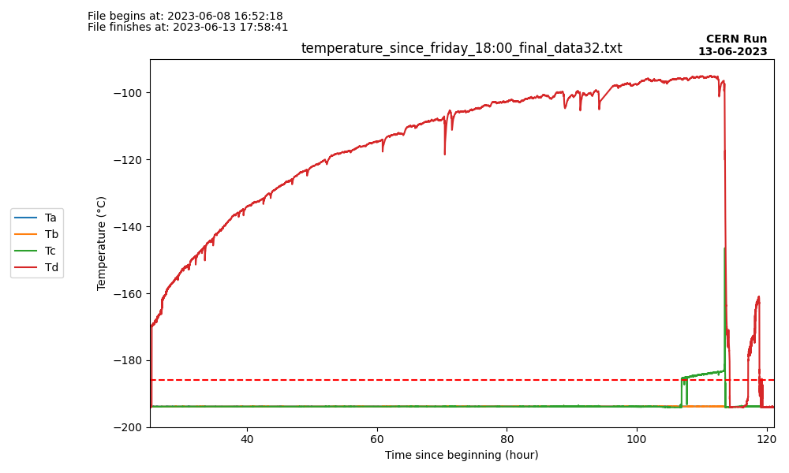
Temperature changes since Friday 6PM
Tank refill
LAr Temperature

Slide 4
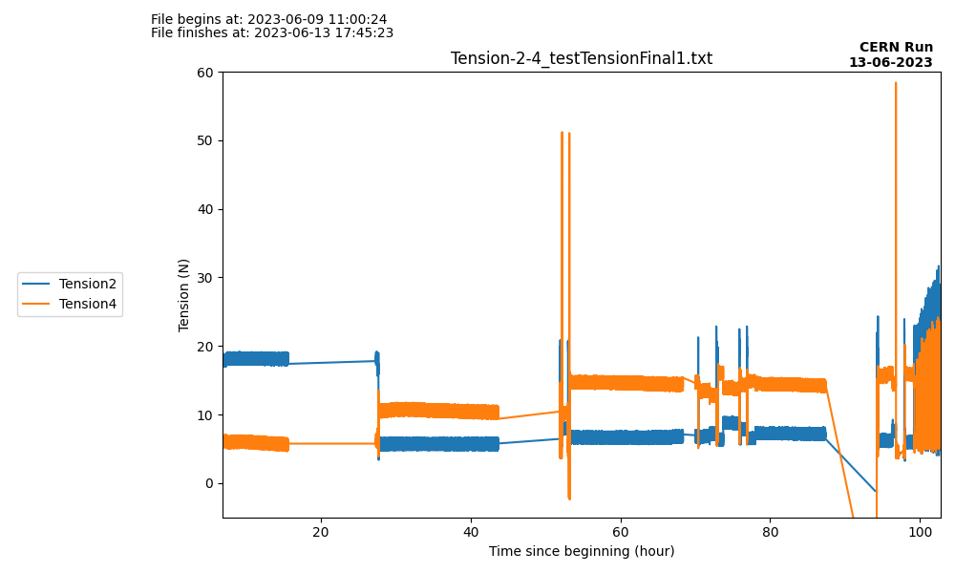
Temperature changes since Friday 6PM
Manip issue discussed on slide 9
Manip issues discussed on slide 7

Slide 5
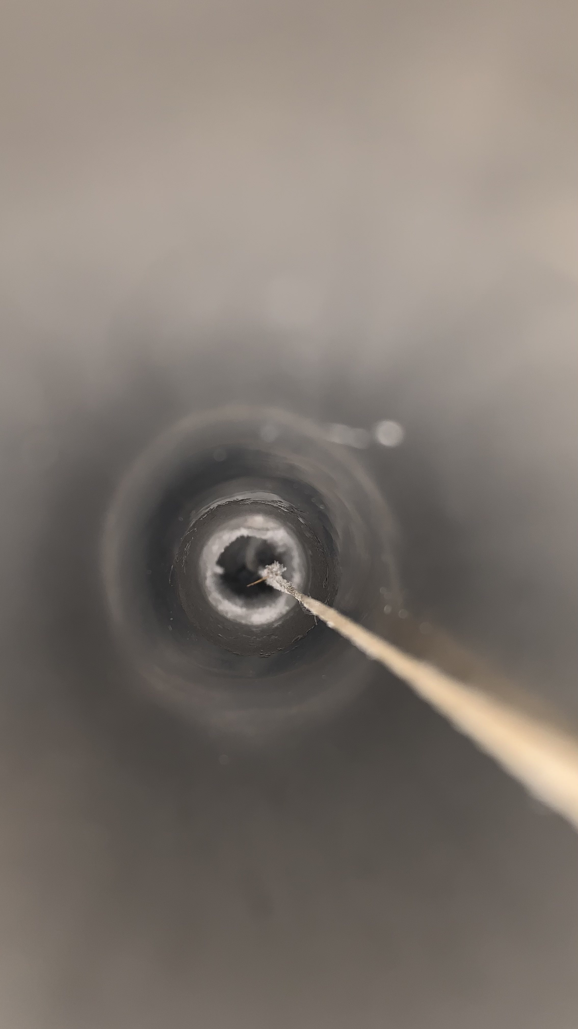
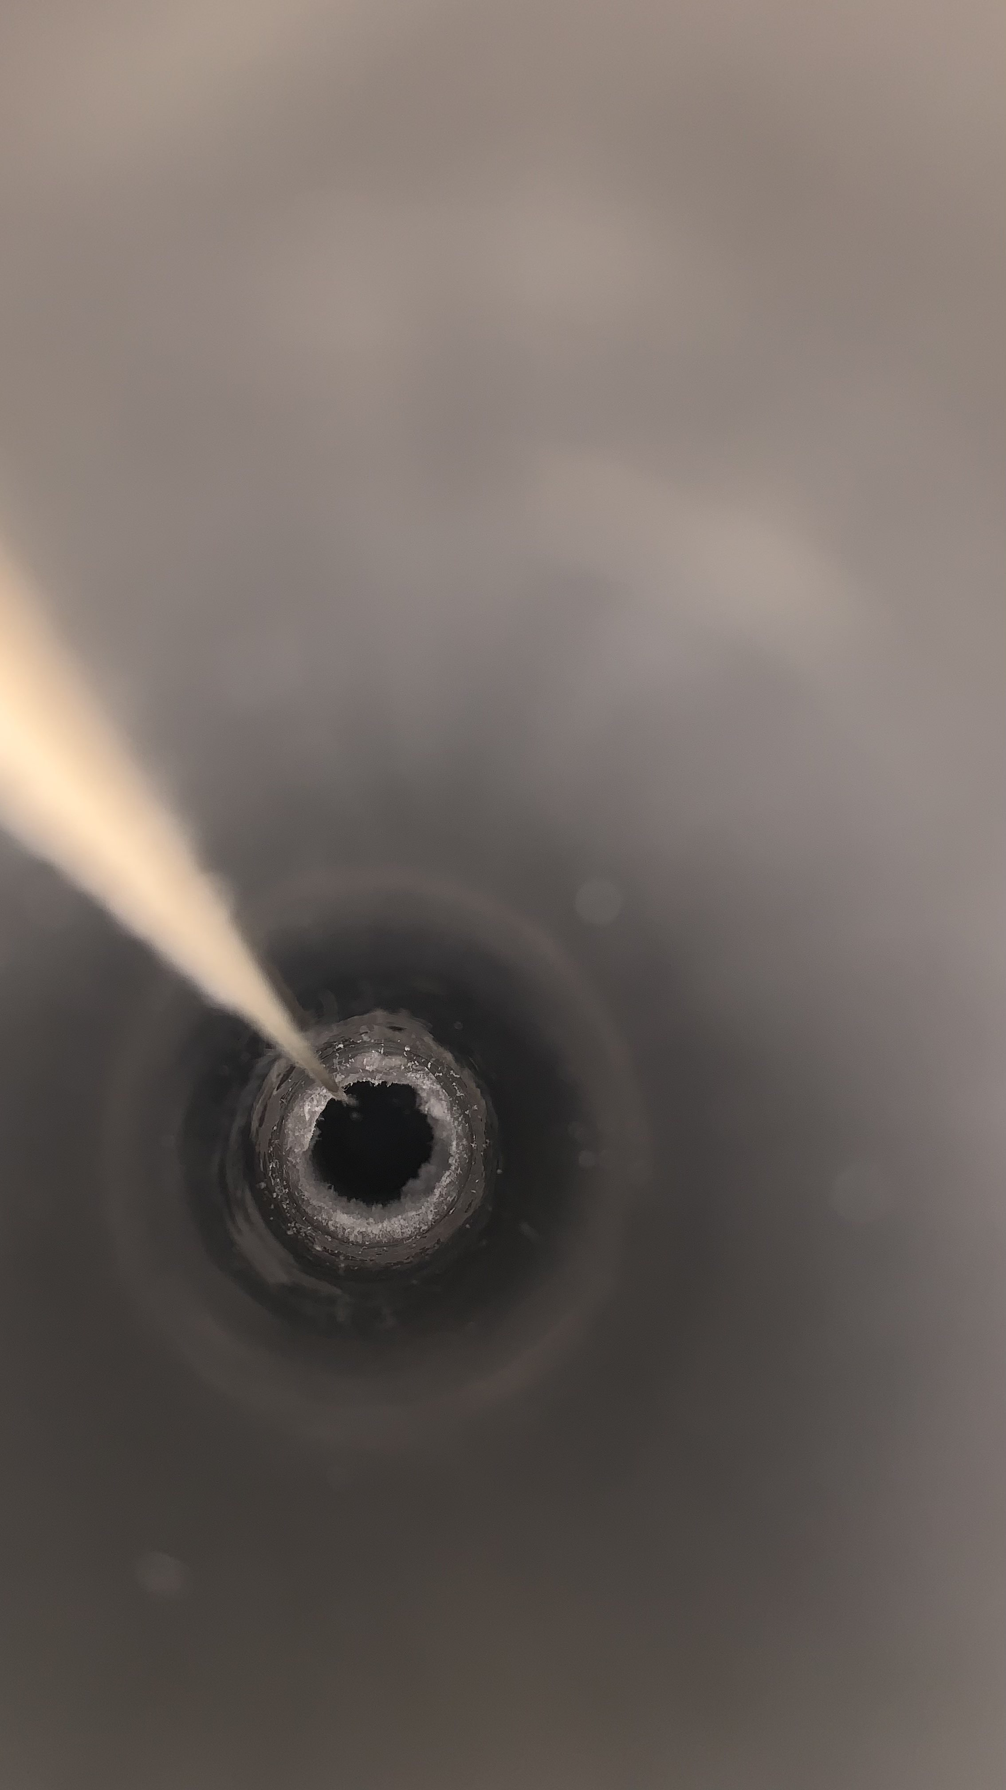
Commentaries : Friday - 06/09 18:00
Peter and Pascal was there, no other commentary needed.
Picture from the top of the left tube
Picture from the top of the right tube

Slide 6
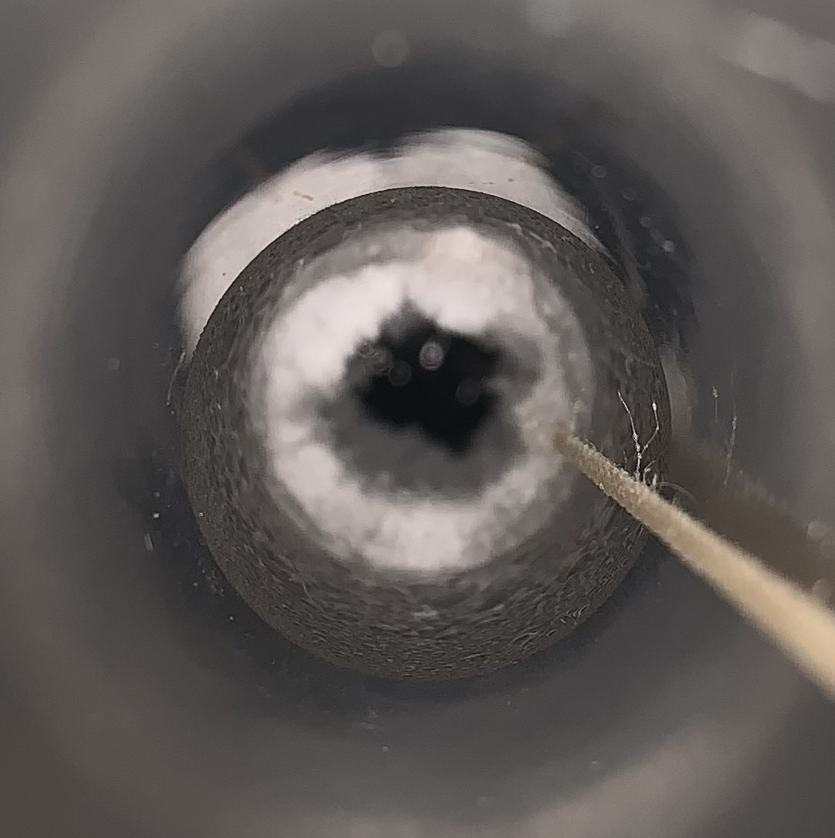
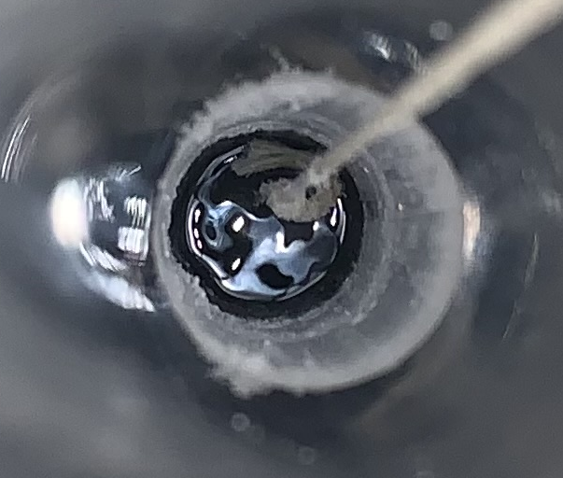
Commentaries : Saturday - 06/10 14:31
Seems to have LN2 at the bottom of the tube : might prevent ice formation ? Need to check tension inside.
I thought ice was blocking the source, but by checking tension it seems fine.
Every other parameter seems fine.
Cryo level dropped by 5% in 20h. So ~6%/day ? I’ll check on Sunday
Monitoring for motors stopped around 2AM (on Saturday). I had to put it back on.
Picture from the top of the left tube
Picture from the top of the right tube

Slide 7
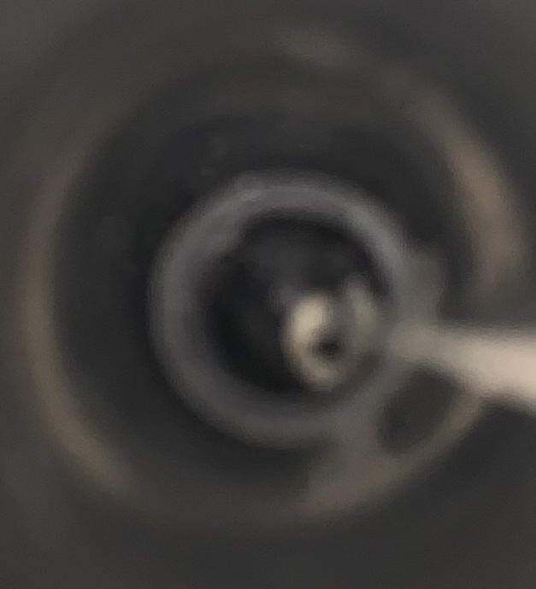
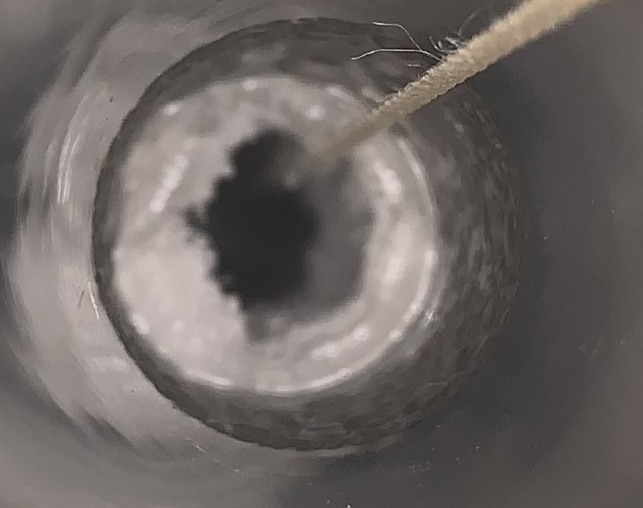
Commentaries : Sunday - 06/11 14:53
Monitoring stopped again at 6:45 AM. 16h 16min from the start. It was ~15h yesterday. The program seems to stop around those time (15h after starting).
By forgetting to put the lid on the left tube, the plastic cap blocked the pulley and stop the movement. Fixed it by relax, putting rope back on pulley then locate and move it back to its position.
6% less LN2 in the tank. So, it seems 6%/day.
Liquid air inside tube, around 50cm from the top (position 570).
Every other parameters seems fine
Picture from the top of the left tube
Picture from the top of the right tube

Slide 8
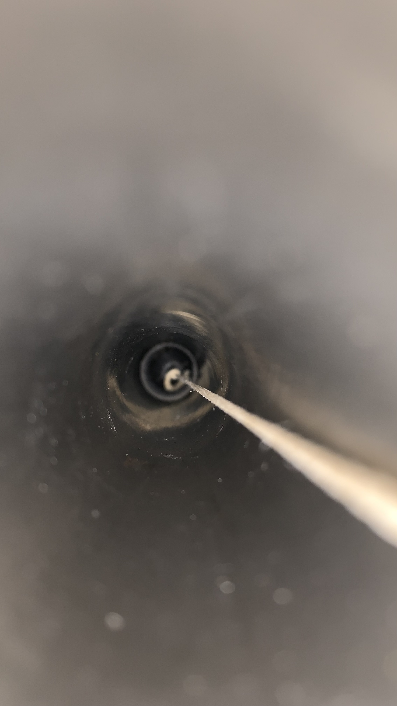
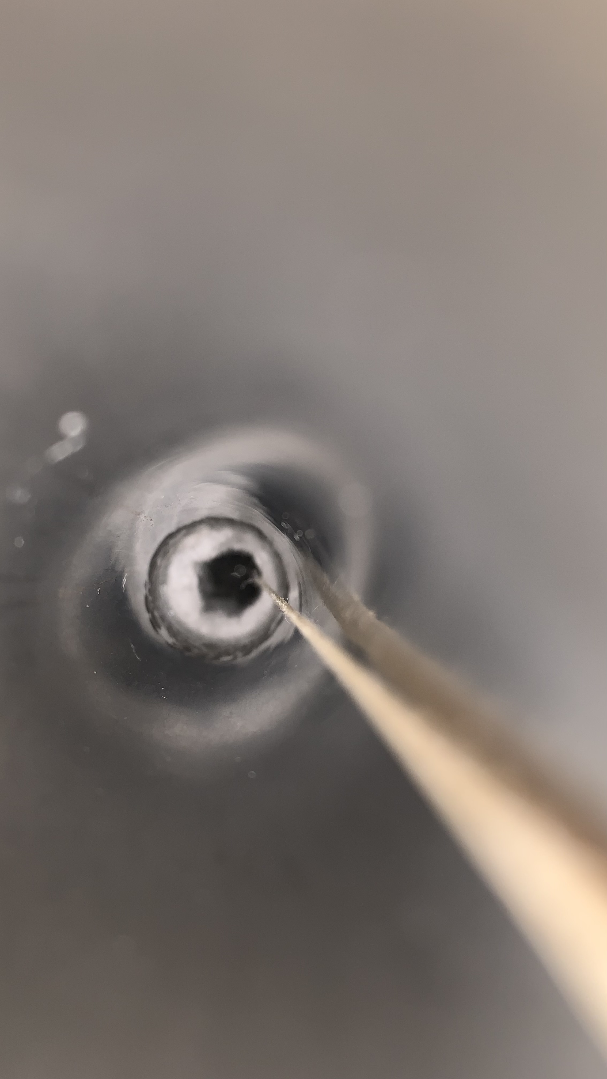
Commentaries : Monday - 06/12 09:10
Monitoring stopped again at 4:44 AM.
5% less LN2 in the tank. So, it seems 6.6%/day.
When flushing with Laetitia (put gN2 at 250 and block air exit on left side), some liquid was seen on the right side.
Every other parameters seems fine
Picture from the top of the left tube
Picture from the top of the right tube

Slide 9
Commentaries : Tuesday - 06/13
Monitoring stopped again at 2:27 AM.
When putting the source at the hot garage, the gN2 tube was stuck. Tension rose at 60N. Relax then take off plastic cap. Shorten the gN2 pipe inside tube (more than 10cm was inside).
Some ice seems to have formed into the left tube (DS4). Maybe too much manipulation (to take pictures, to measure LN2 inside the tube …) increased humidity.
I started the morning program from Marie’s slides. Took 3 hours to complete. Forgot to take the last data to check the drift (I restarted the program before, so data unusable).
Laetitia filled the tank almost completely.

Slide 10
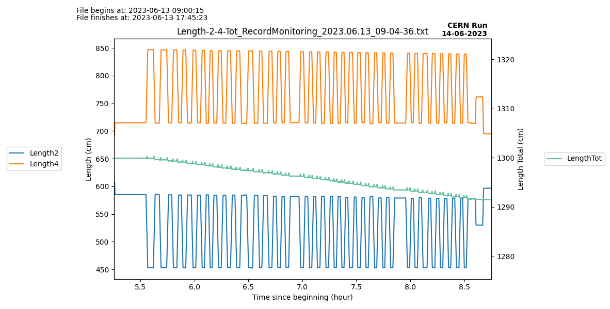
Length on “Morning Routine” 13/06

Slide 11
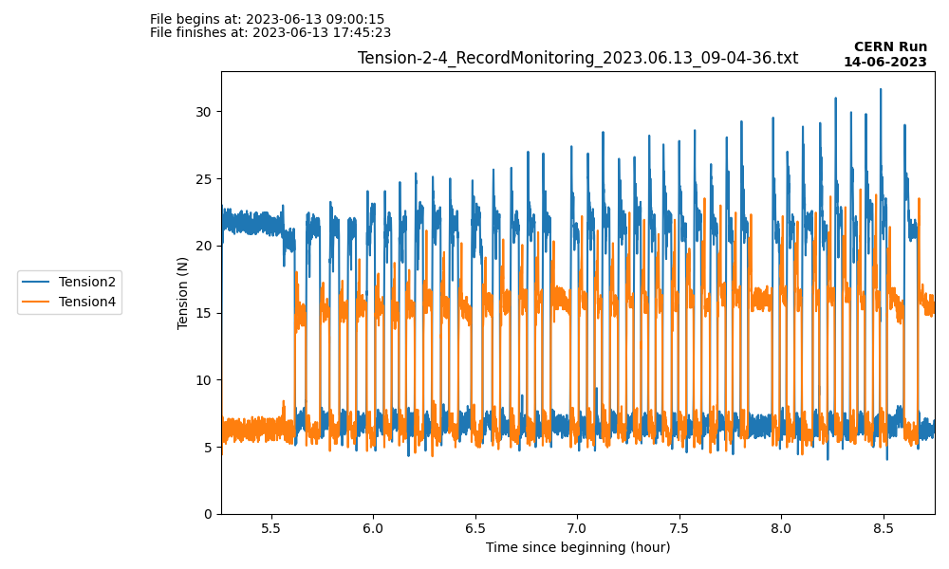
Tension on “Morning Routine” 13/06

Slide 12
Commentaries : Wednesday - 06/14
Pression from battery outside : 150 bar. Need to talk again with Laetitia but seemed ok to her yesterday.
Seems like there is the same amount of ice in both sides. Maybe too much opening of the tube and humidity went inside.
Morning routine went fine. Took 3h. Tension went to 30 for DS2. Around 20 for DS4.

Slide 13
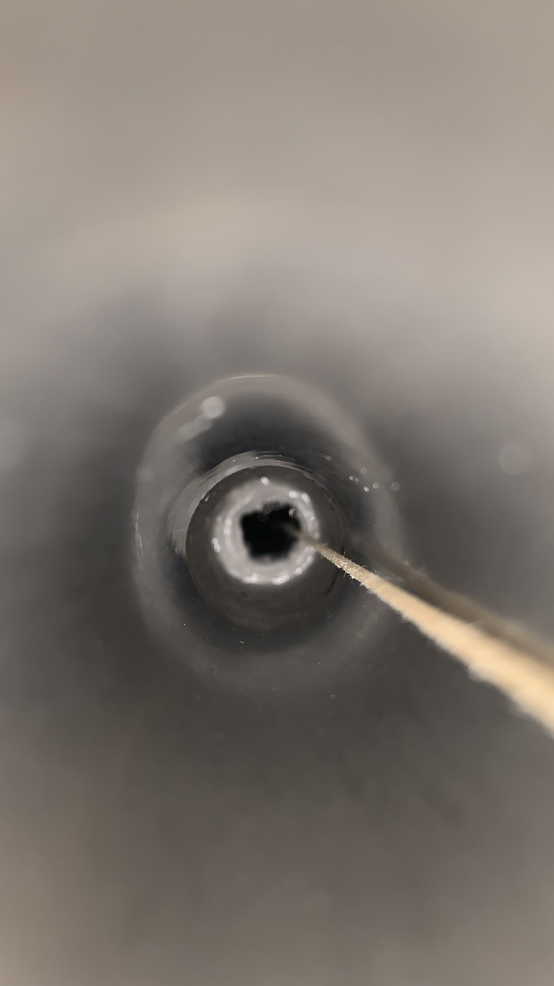
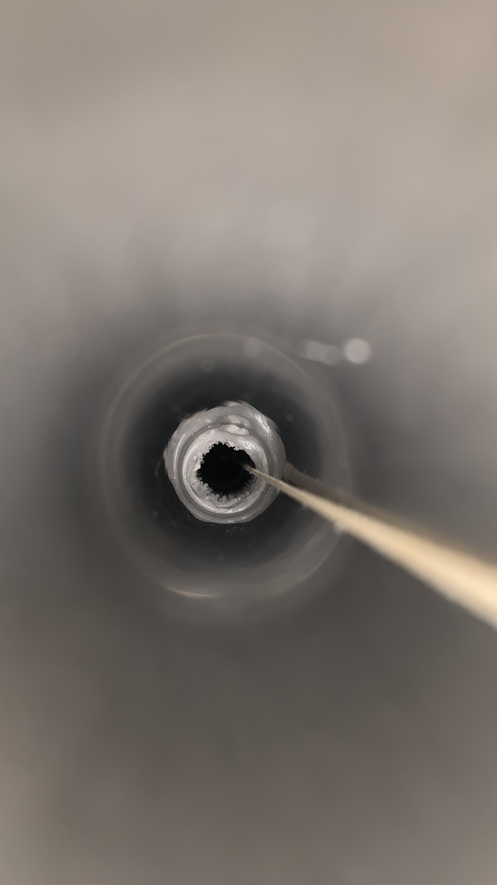
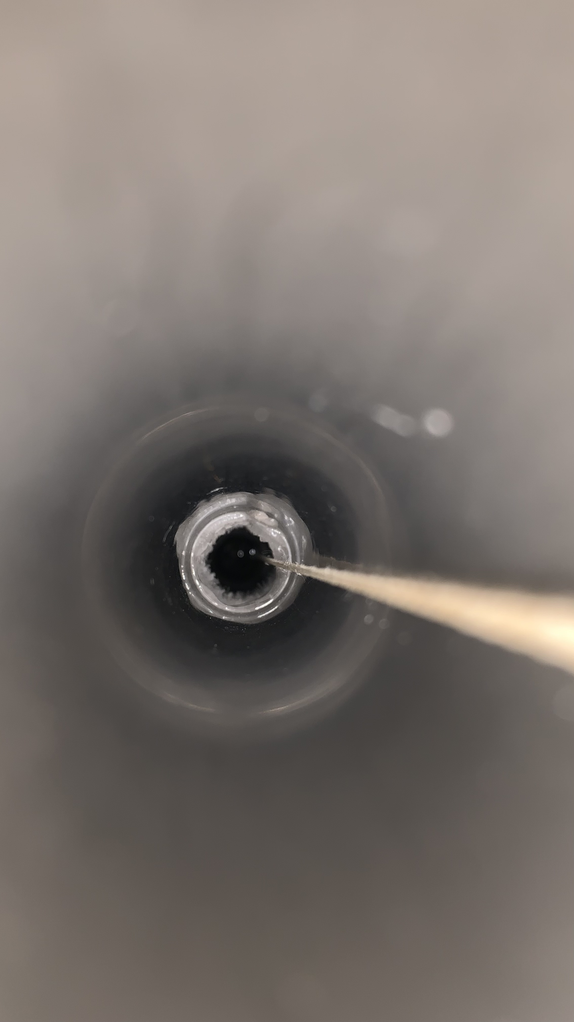
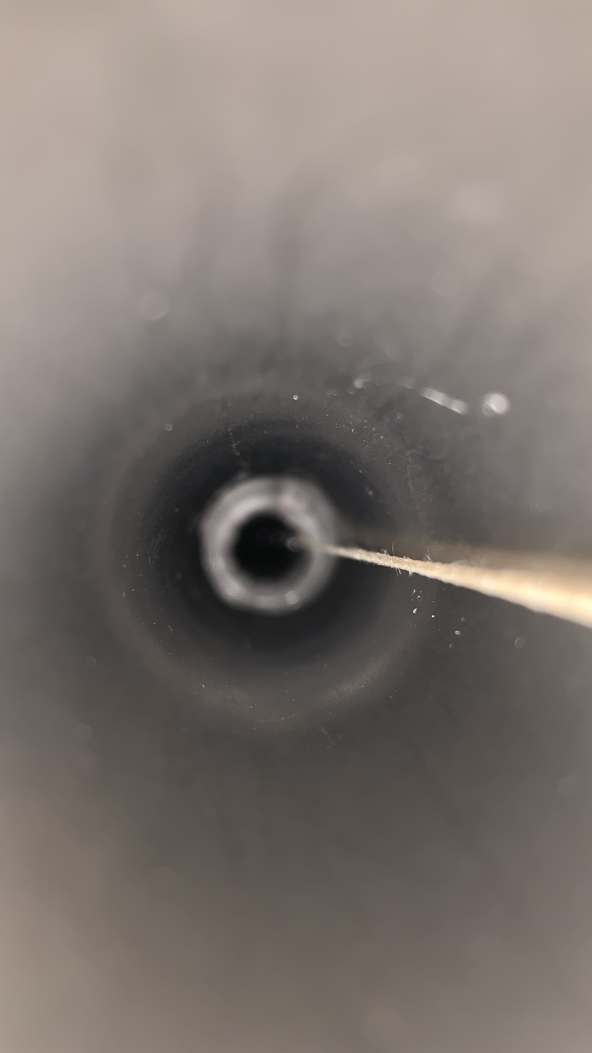
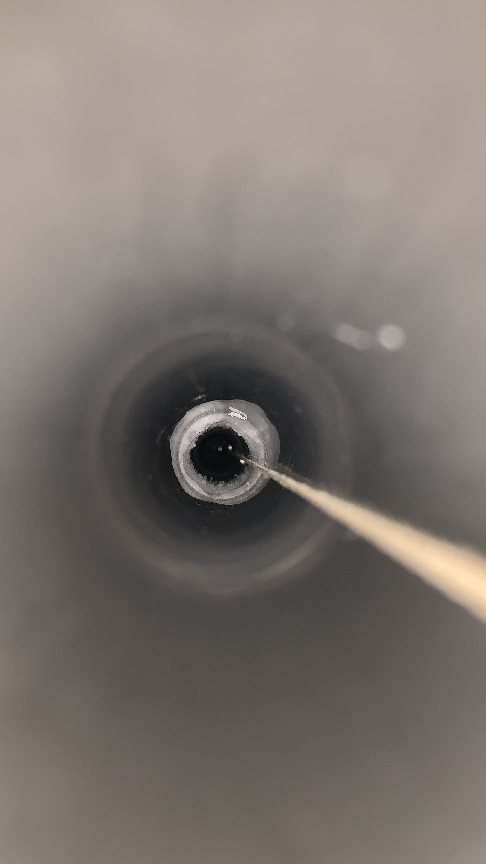
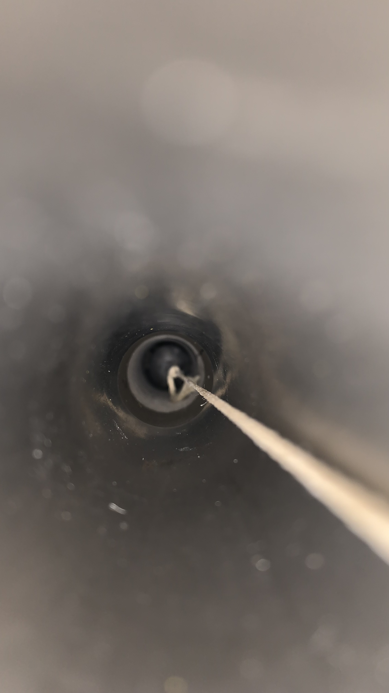
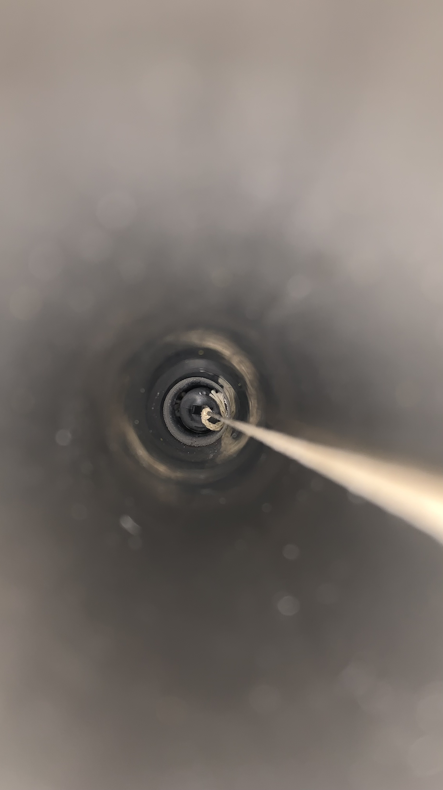
Flushing LN2 at 250L/h to see effect on ice :
Time | 12/06/2023 11:00 | 12:00 | 12:50 | 14:00 | 15:05
Right Side (DS2)
Left Side (DS4)
T shaped gN2 pipe | NO | NO | NO | YES | YES
gN2 Total flow | 250L/h, right side | 250L/h, right side | 250L/h, right side | 250L/h split in both sides | 250L/h split in both sides
LN2 in tube | 56cm from top -> position 564 |  |  |  | 55cm from top -> position 565
%LN2 in tank | 81% | ~ 80% | ~ 80% | ~ 80% | ~ 80%
Pictures are cropped to be visible so do not pay attention on sizes, more on shapes.

Slide 14
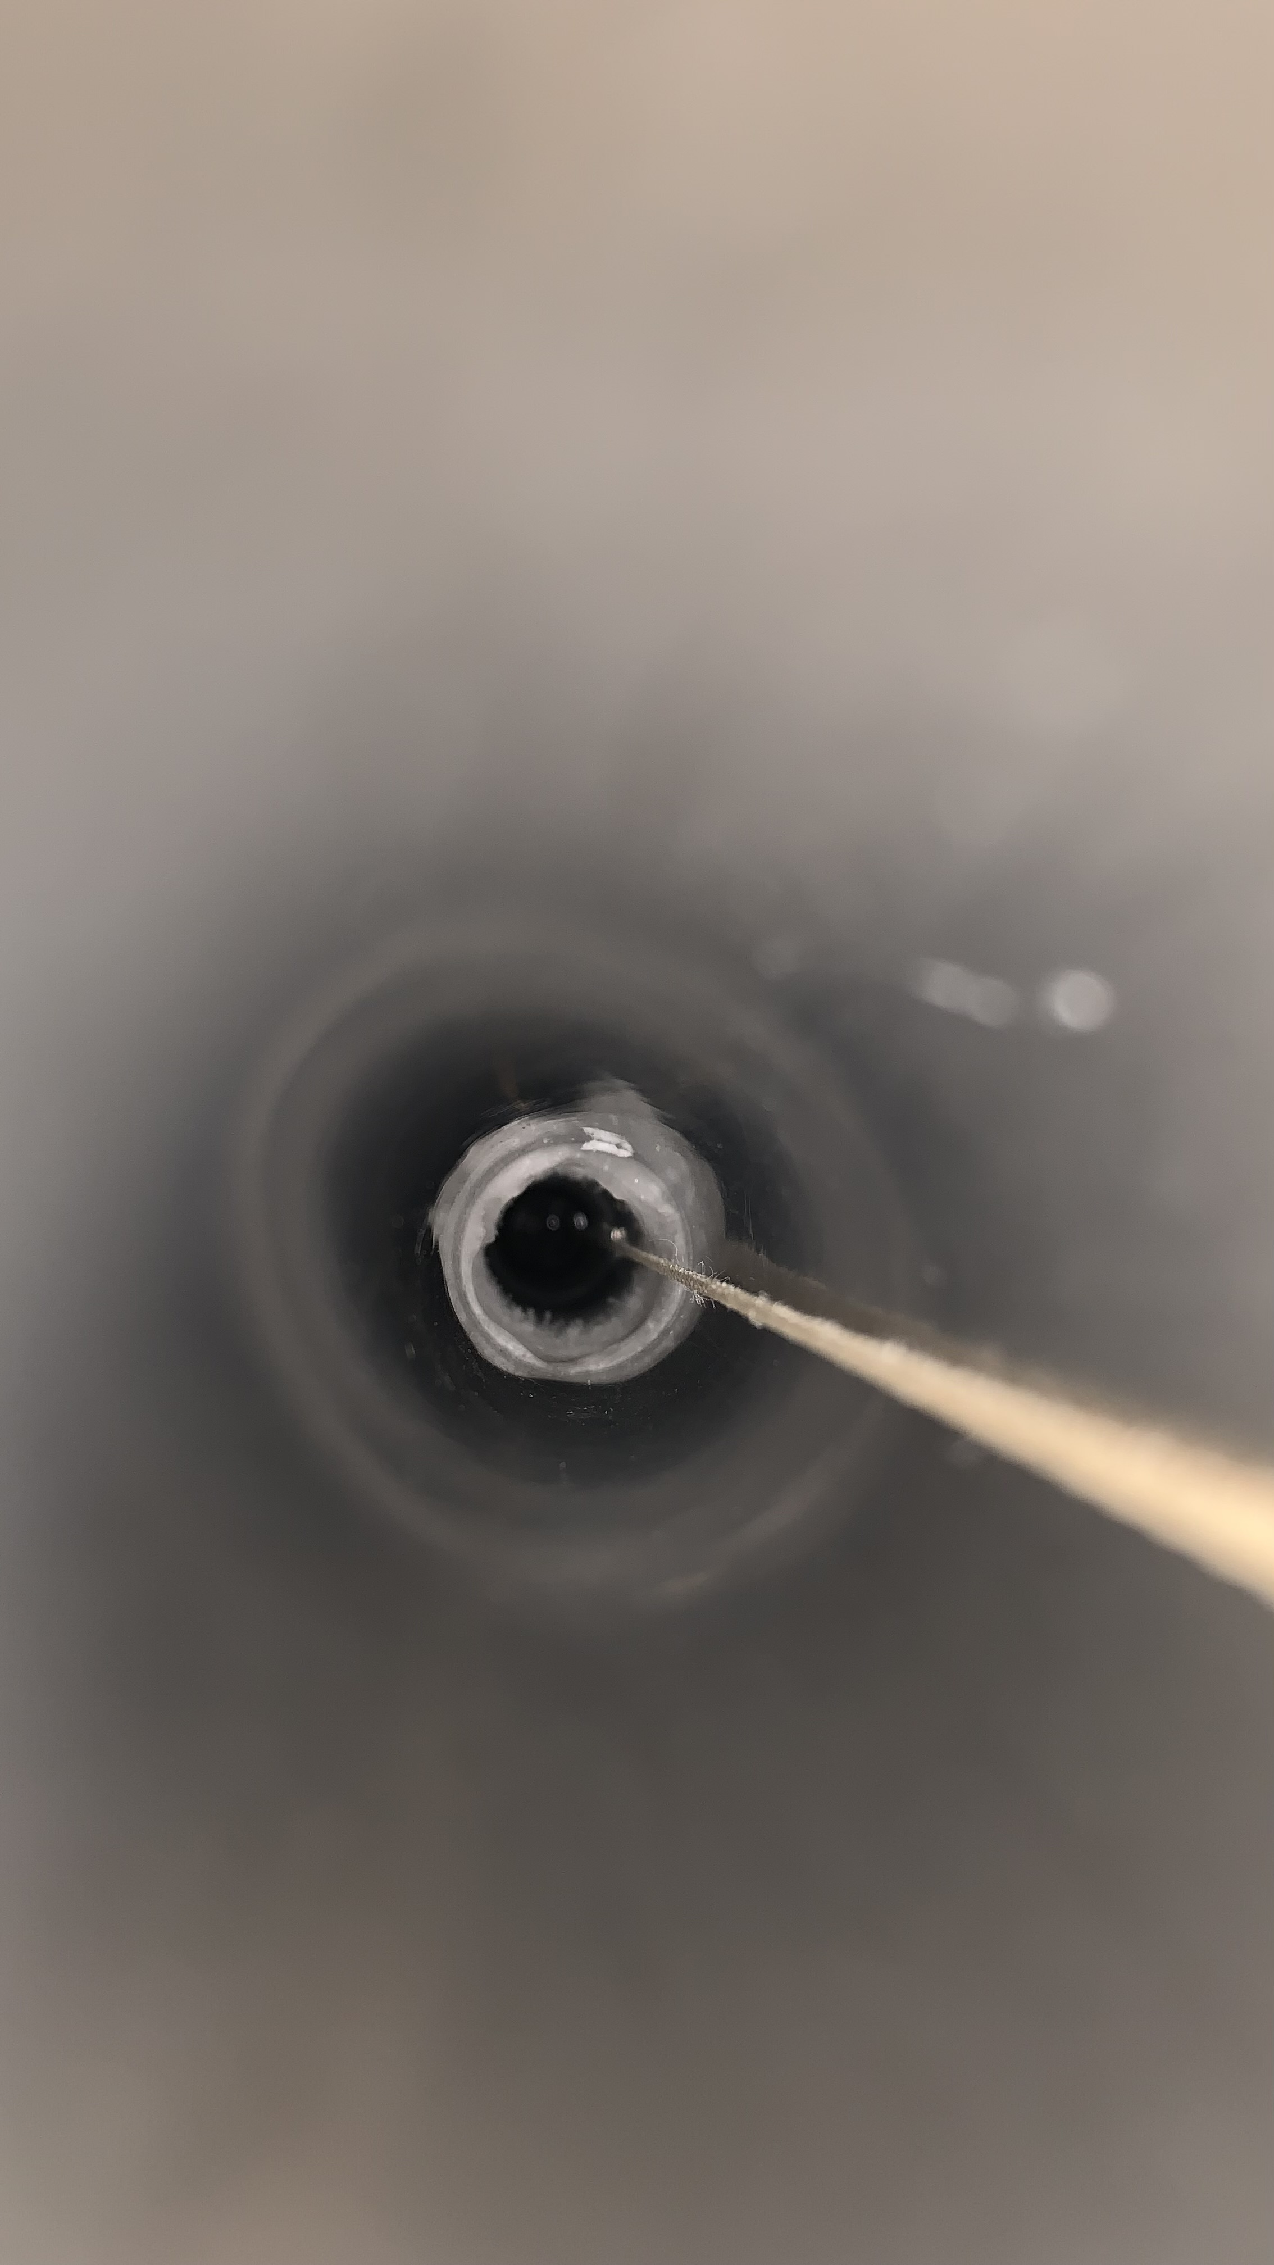
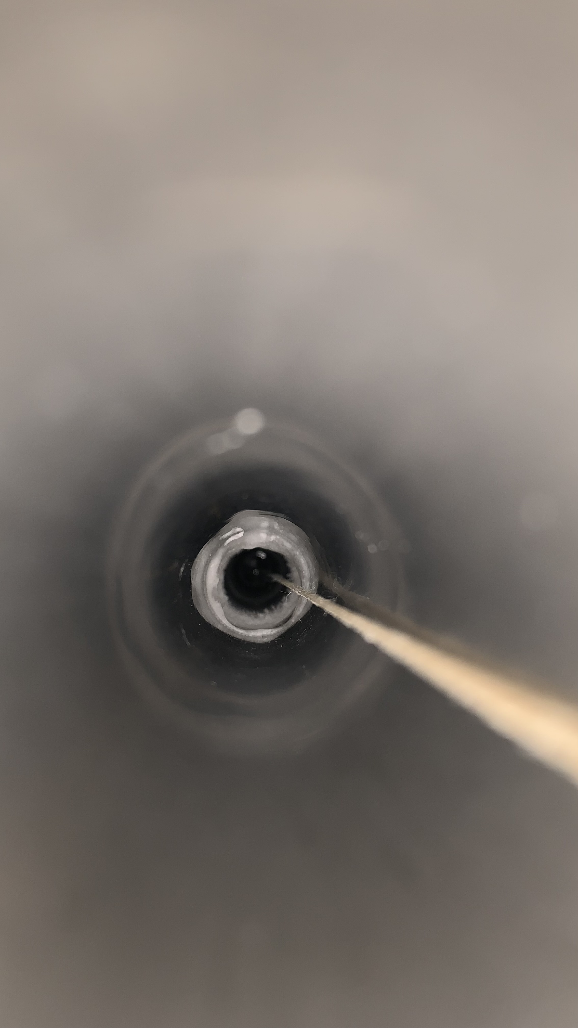
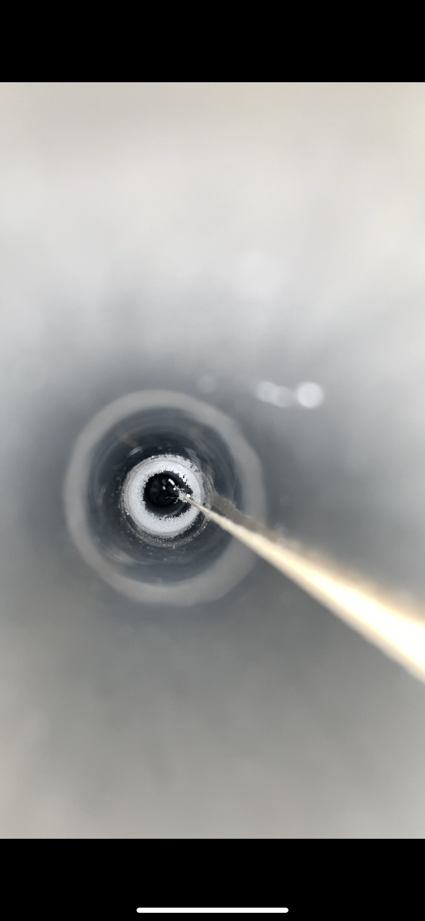
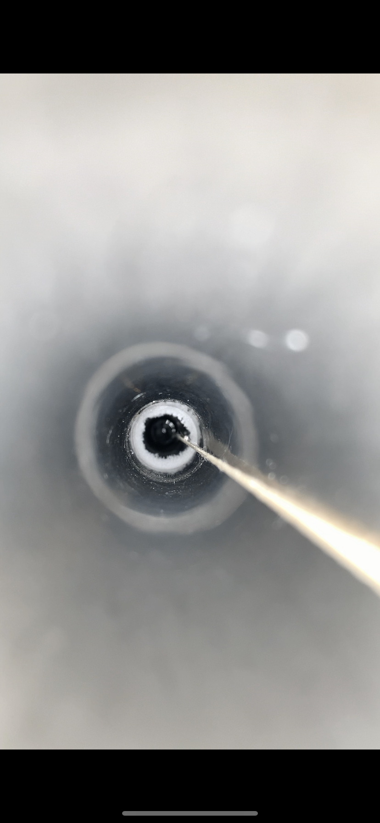
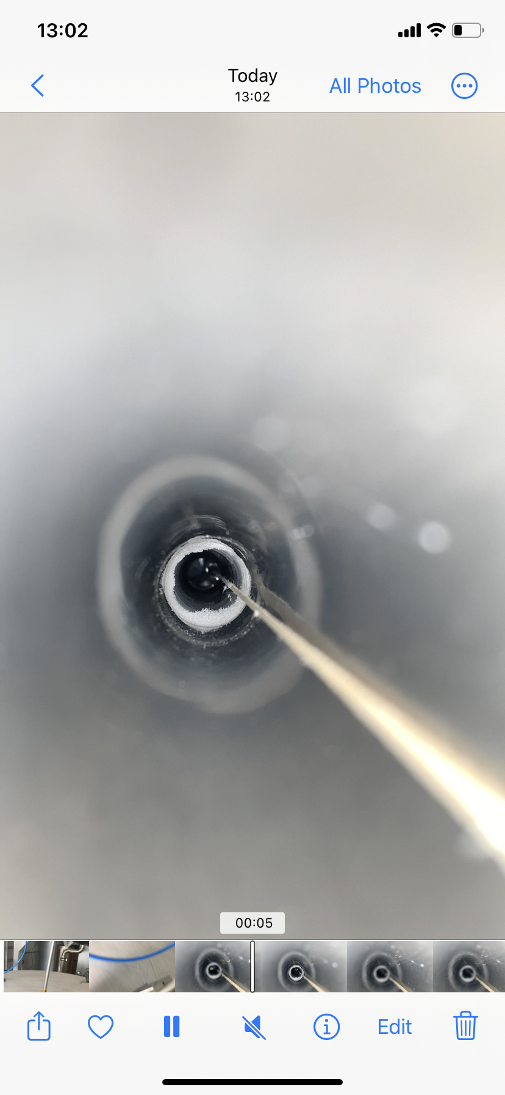
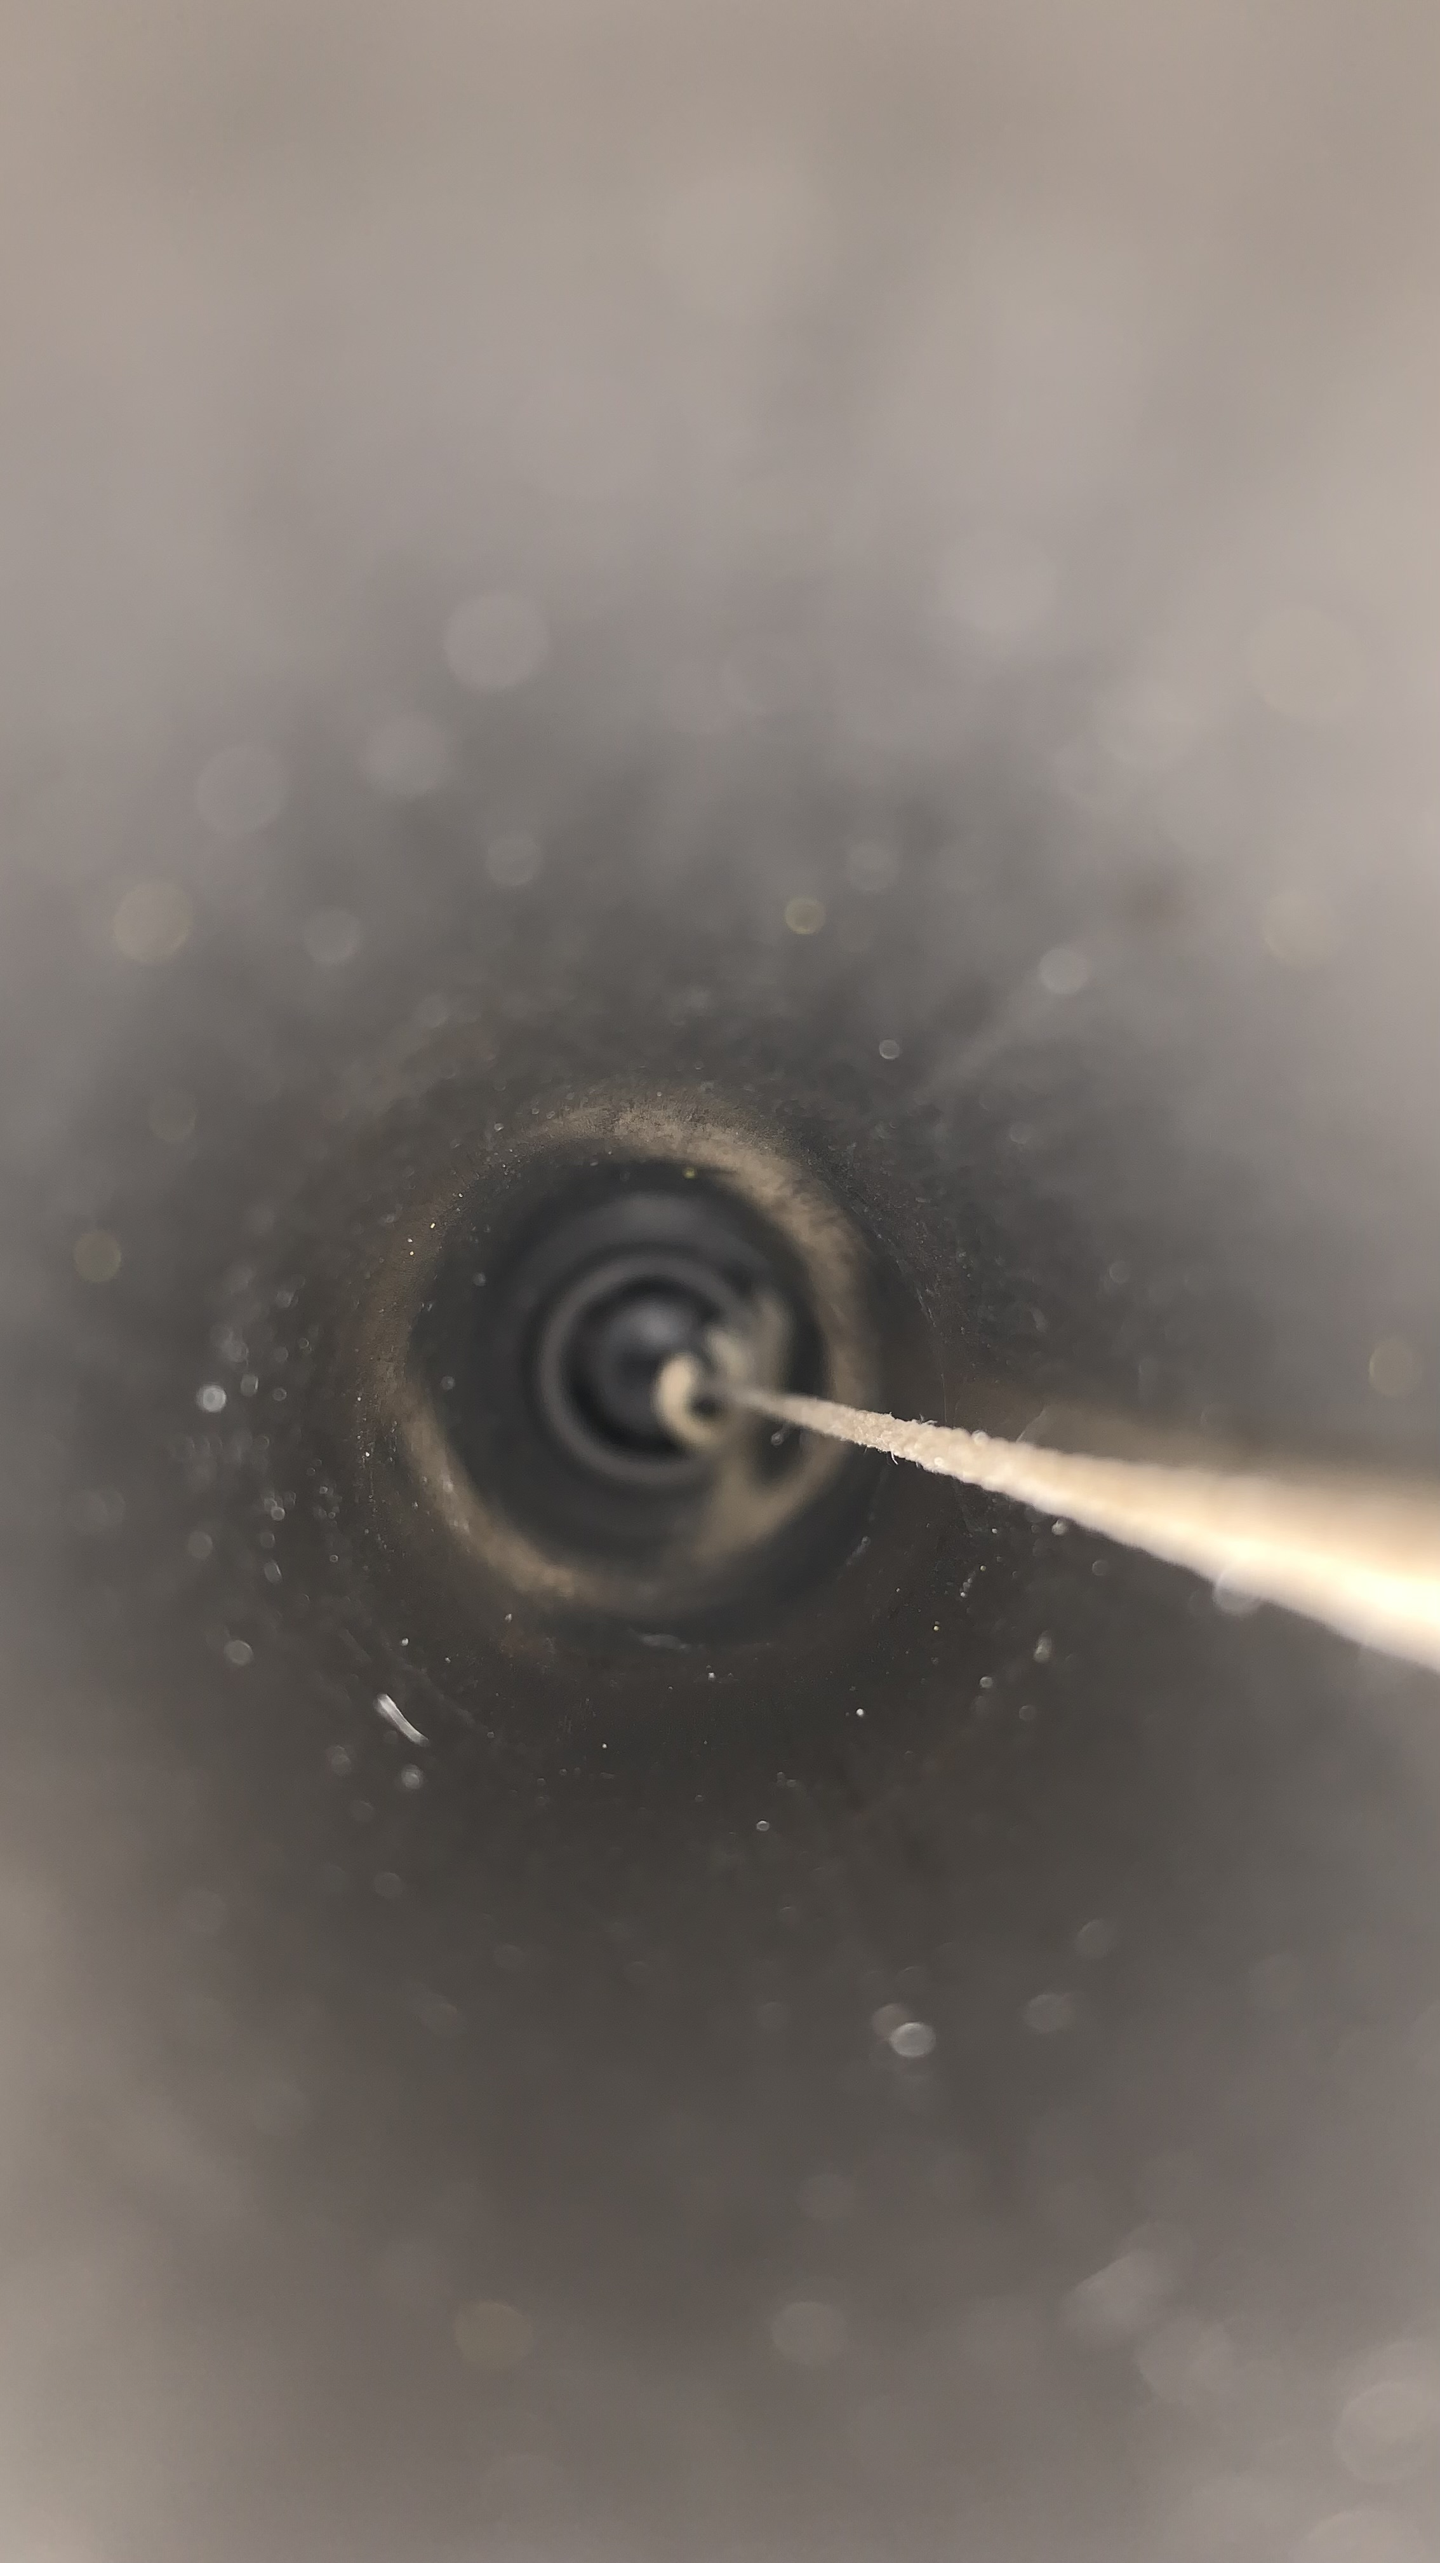
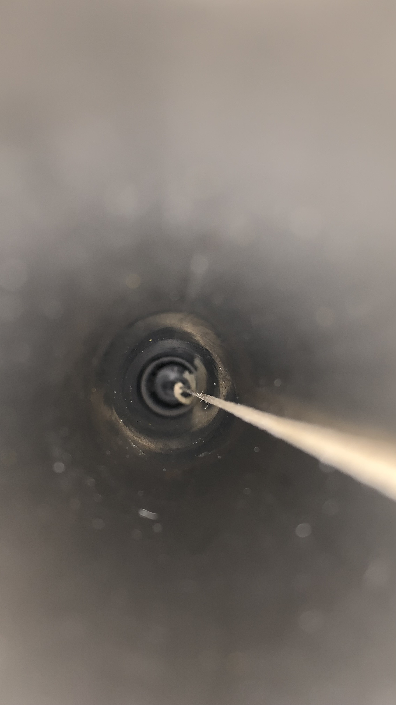
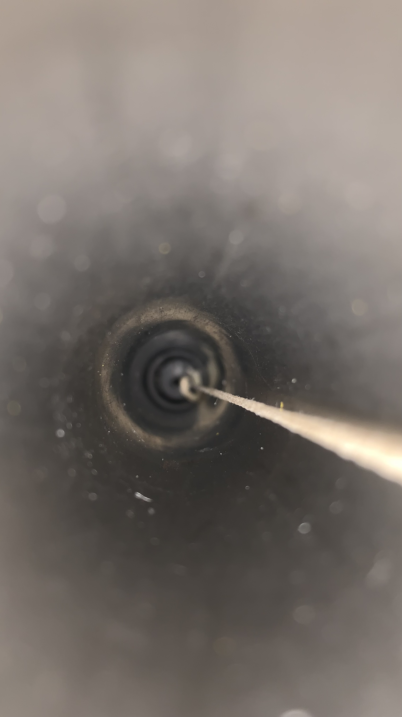
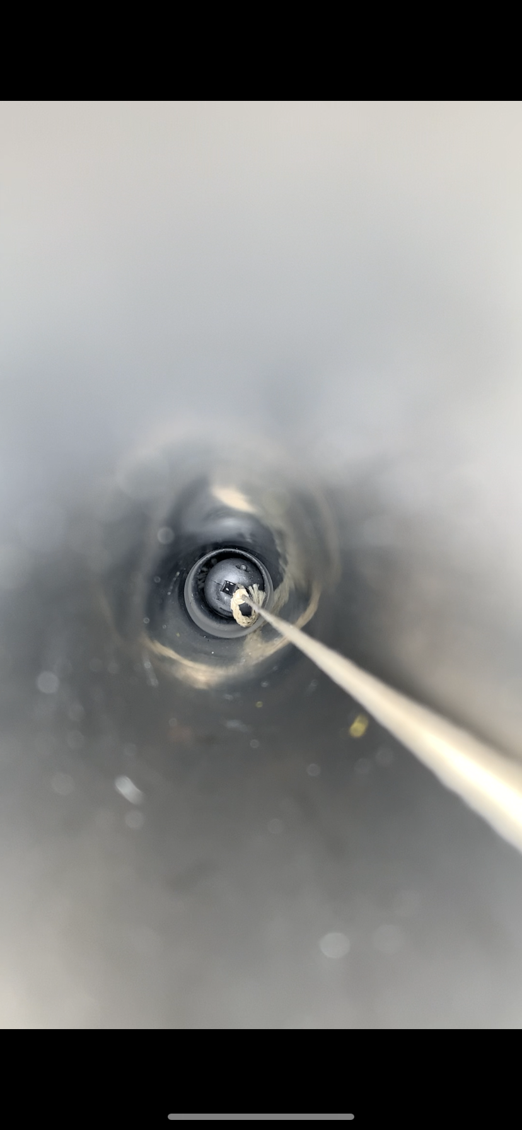
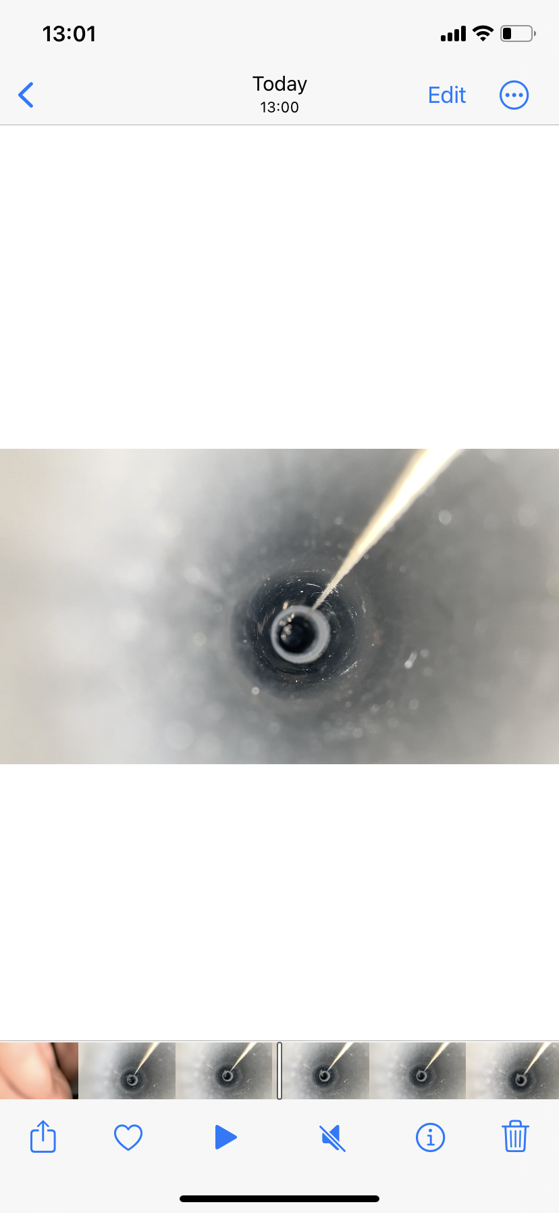
Flushing LN2 at 250L/h to see effect on ice :
Time | 16:00 | 17:00 | 13/06/2023 9:00 | 11:25 | 13:00
Right Side (DS2)
Left Side (DS4)
T shaped gN2 pipe | YES | YES | YES | YES | YES
gN2 Total flow | 250L/h | 250L/h | 250L/h | 250L/h | 250L/h
LN2 in tube | 56cm from top -> position 564 |  |  |  | 58 from top -> position 562
% LN2 in tank | ~ 80% | ~ 80% | 75% | ~98% | 98.4%
Pictures are cropped to be visible so do not pay attention on sizes, more on shapes.

Slide 15
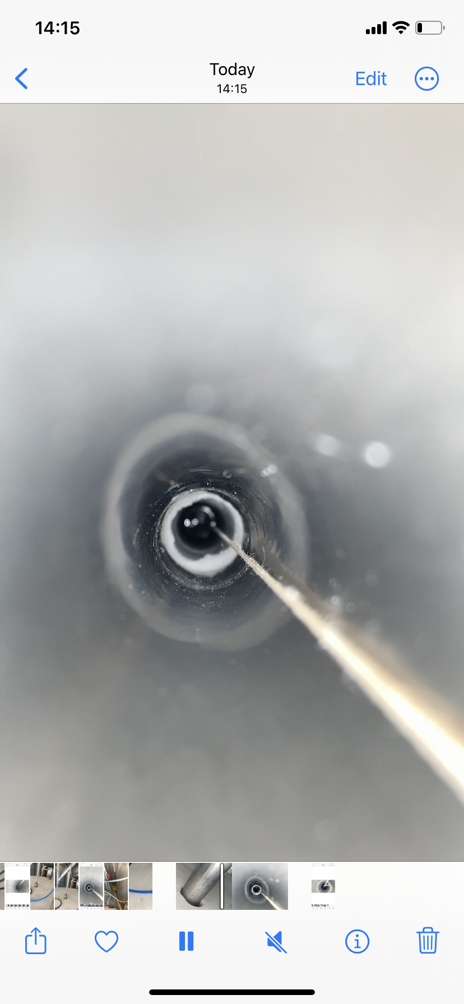
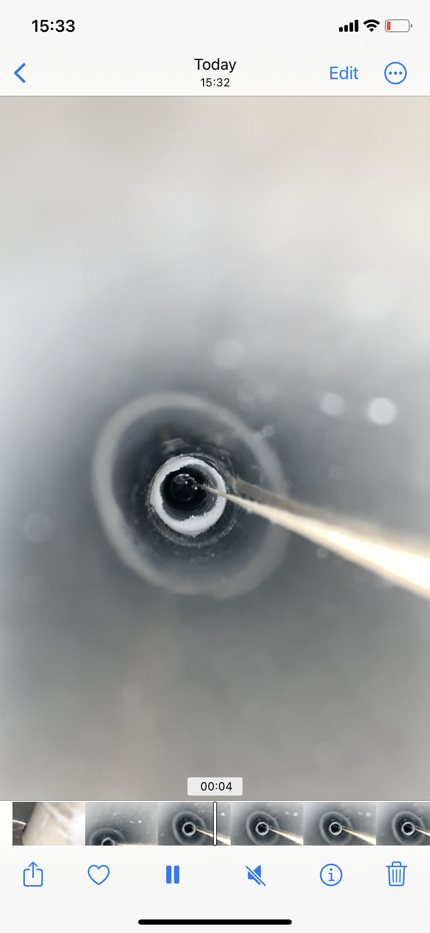
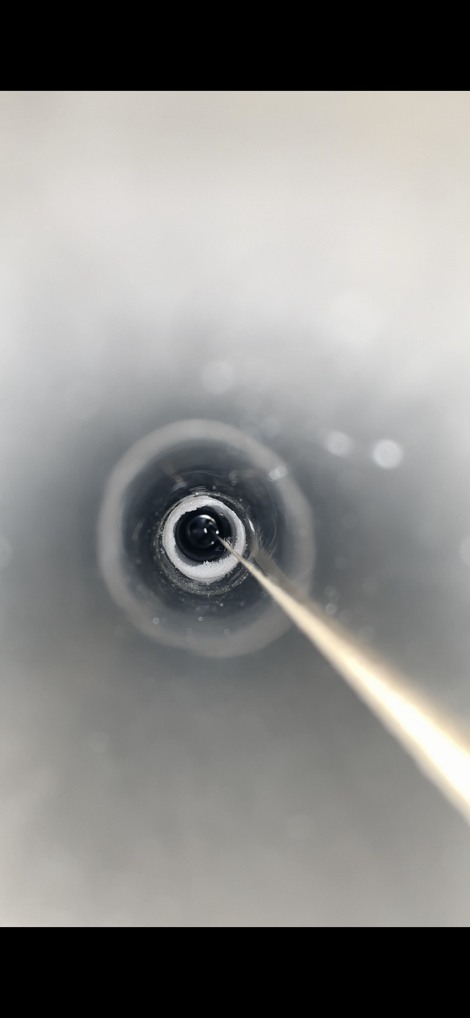
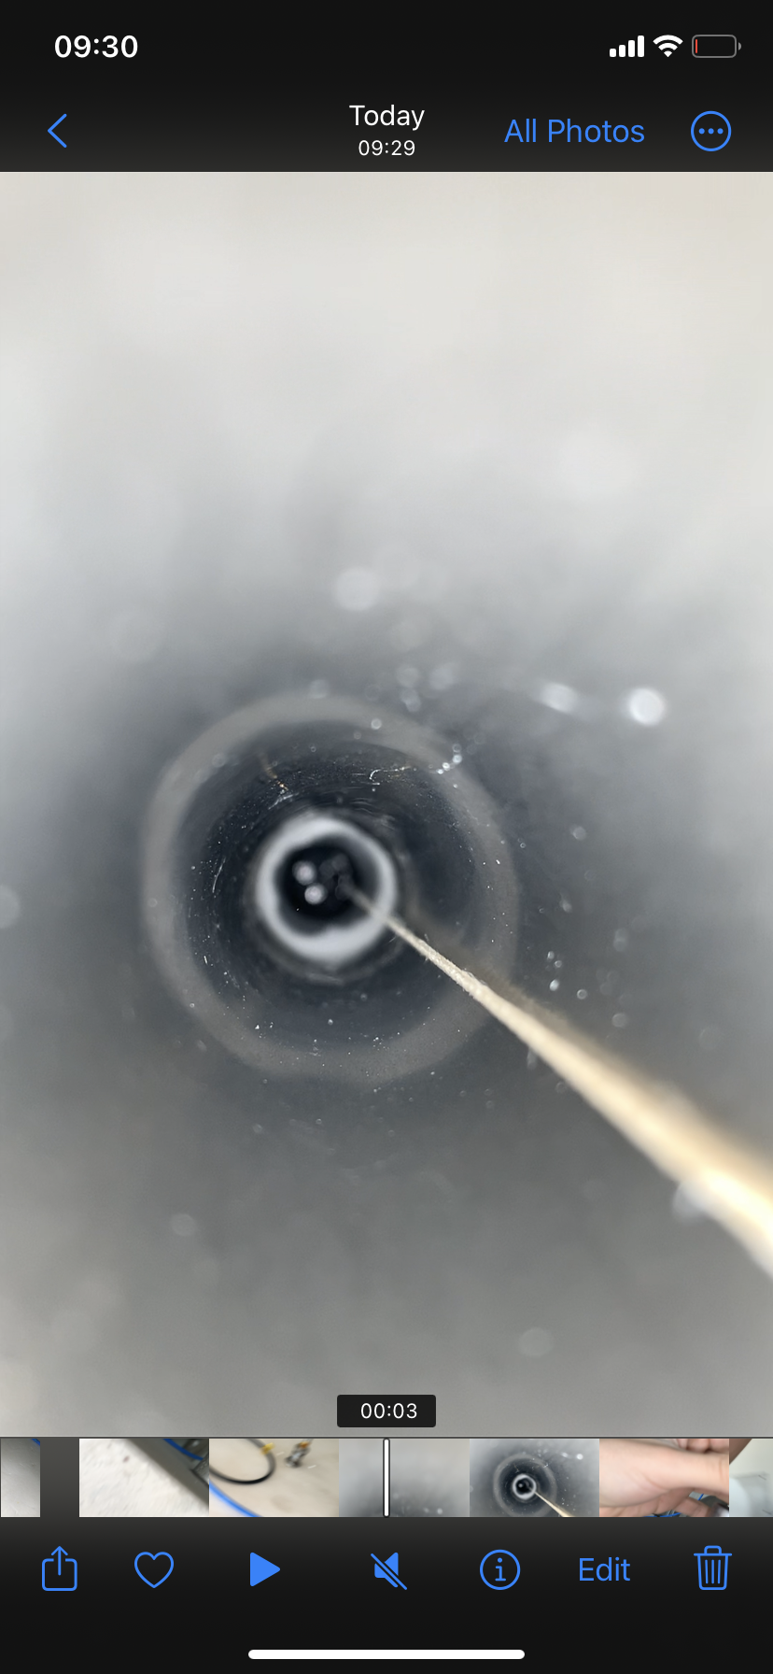
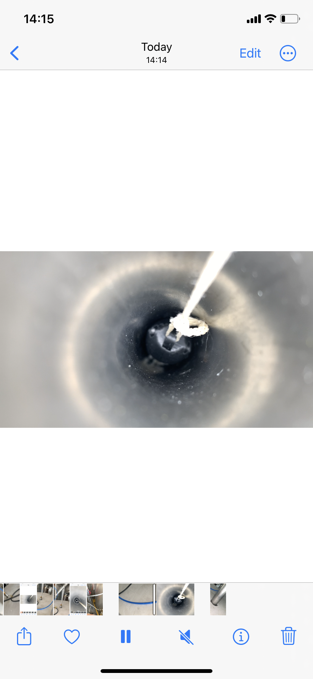
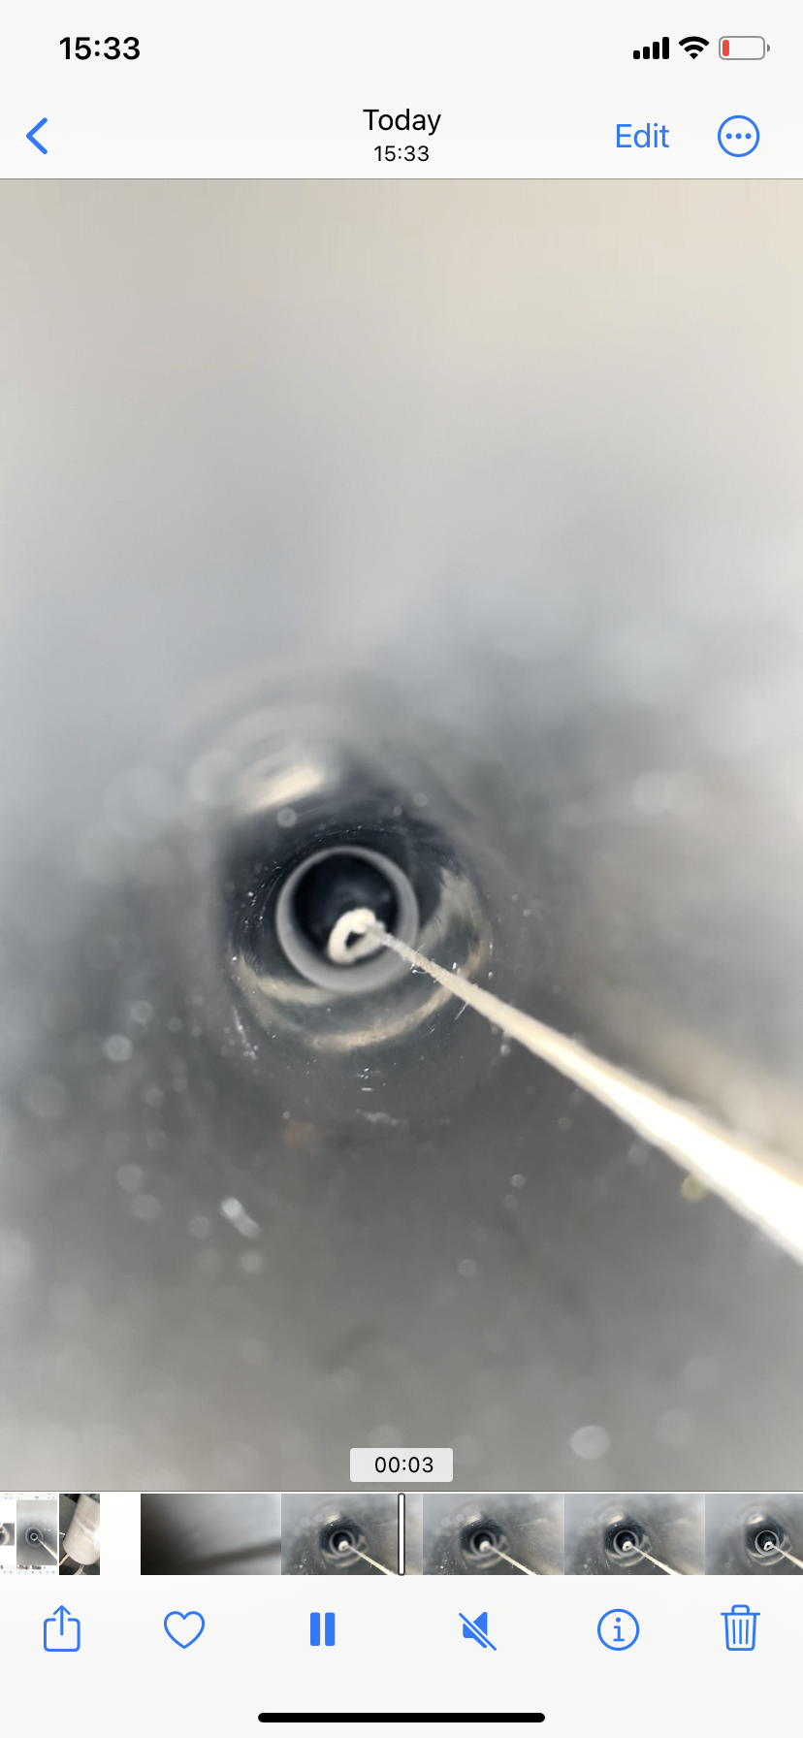
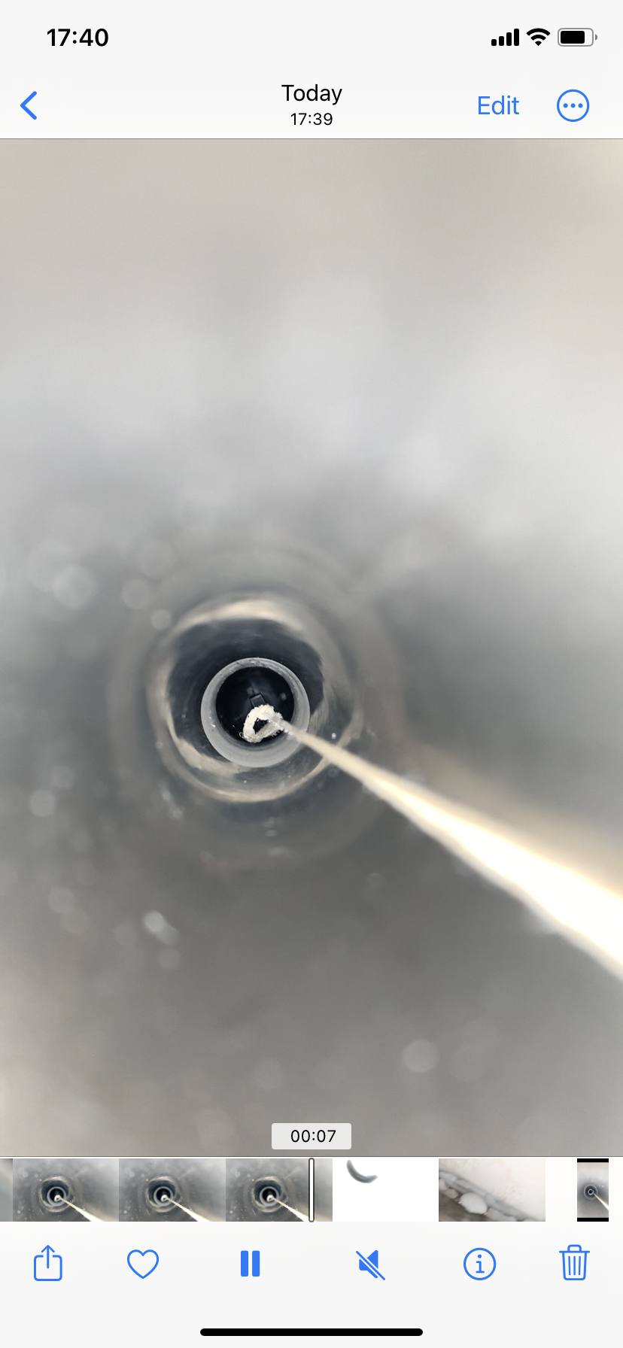
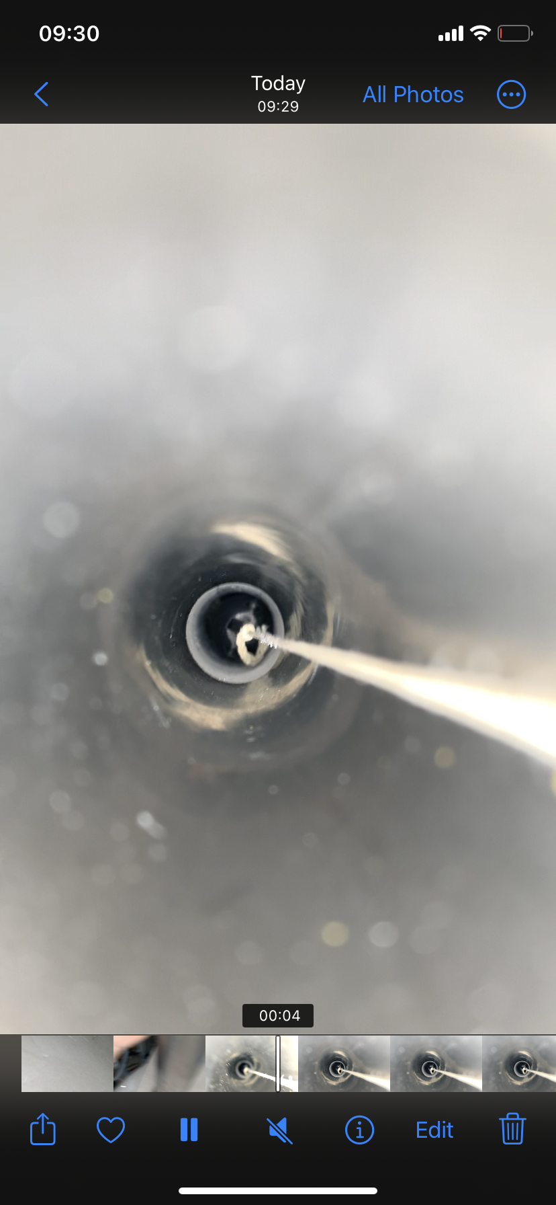
Flushing LN2 at 250L/h to see effect on ice :
Time | 14:14 | 15:30 | 17:30 | 9:30
Right Side (DS2)
Left Side (DS4)
T shaped gN2 pipe | YES | YES | YES | YES
gN2 Total flow | 250L/h | 250L/h | 120L/h | 120L/h
LN2 in tube |  | 54cm so position 566 | 52 so position 568
% LN2 in tank | 98% | 97,5% | 99% | 95%
Pictures are cropped to be visible so do not pay attention on sizes, more on shapes.

